Slide 1




NEXT GEN EMPLOYABILITY PROGRAM
Creating a future-ready workforce
Team Members
College Name
Student Name :K.K.Archana
Student ID : au960221104024
Arunachala College of Engineering for Women

Slide 2

CAPSTONE PROJECT SHOWCASE
Project Title
Car Rentals Application with Django Framework
Abstract | Problem Statement | Project Overview | Proposed Solution | Technology Used | Modelling & Results | Conclusion

Slide 3
Abstract
Our car rentals application, powered by the Django framework,revolutionizes the traditional car rental process by offering a seamless and user-friendly platform. With features such as user authentication, advanced car search, secure payment integration, and intuitive booking management, users can effortlessly find and book their desired vehicles. Developed using Django for backend, HTML/CSS/JavaScript for frontend, and PostgreSQLL for data storage, our application ensures scalability and reliability. Following agile methodologies, we prioritize user feedback, resulting in a refined and efficient platform. Initial testing demonstrates positive user experiences, highlighting the potential of our application to transform the car rental industry. In conclusion, our Django-based car rentals application provides a modern solution to streamline the rental process, offering convenience and efficiency to users.
Source :

Slide 4
Problem Statement
Traditional car rental processes are often plagued by inefficiencies and complexities, leading to user frustration and suboptimal experiences. Manual booking systems, lack of user-friendly interfaces, and inadequate search functionalities hinder users from easily finding and renting vehicles. Additionally, security concerns surrounding payment transactions and the lack of efficient booking management systems further exacerbate the challenges faced by both users and rental providers. Consequently, there exists a pressing need for a modernized solution that simplifies the car rental process, enhances user experience, ensures secure transactions, and streamlines booking management.
Source :

Slide 5
Project Overview
The car rental application developed using the Django framework aims to provide a comprehensive solution for users to rent vehicles with ease. Leveraging Django's robust features, the application offers a seamless platform for both users and rental providers. Users can browse through a diverse range of vehicles, select their preferred options, and complete the booking process efficiently.
Source :

Slide 6
Proposed Solution
.
Our solution is a Django-based car rental application with a user-friendly interface, comprehensive car listings, advanced search filters, and secure payment integration. Users can efficiently manage bookings through a centralized dashboard, while rental providers have access to an admin dashboard for inventory management. Real-time availability updates, responsive design, and a feedback system enhance the overall user experience. By leveraging Django's robust features and modern development practices, we aim to provide a streamlined and reliable platform for both users and rental providers, revolutionizing the car rental process.
Source :

Slide 7
User-Friendly Interface: The application boasts a sleek and user-friendly interface, ensuring effortless navigation and a seamless booking experience for users.
Comprehensive Car Listings: Users can browse through an extensive selection of vehicles, with detailed descriptions, images, and pricing information provided for each listing.
Advanced Search Filters: To facilitate quick and precise vehicle selection, the application offers robust search filters, enabling users to filter results based on criteria such as location, date, car type, and rental duration.
Secure Payment Integration: Seamless integration with secure payment gateways ensures that transactions are processed safely and efficiently, providing users with confidence and peace of mind.
Source :

Slide 8
Real-Time Availability: The application incorporates real-time availability updates, allowing users to see which vehicles are available for their desired dates and locations instantly.
5) Feedback and Rating System: To foster transparency and, the application includes a feedback and rating system, enabling users to provide reviews and ratings based on their rental experiences.
6) Responsive Design: The application is designed to be responsive across various devices and screen sizes, ensuring optimal performance and usability on desktops, tablets, and mobile phones.
Source :

Slide 9


Technology Used
Front-end
Back-end
Source :

Slide 10
Modelling & Results
Utilizing Django's ORM, our application features a robust database model representing users, vehicles, bookings, and rental providers, ensuring data integrity and efficient relationships.
Through user testing, our application has shown significant improvements in user satisfaction, with faster booking processes and reduced errors.
Real-time availability updates and advanced search filters have enhanced the user experience, leading to higher conversion rates and increased revenue for rental providers.
The secure payment integration has instilled trust among users, resulting in seamless and secure transactions.
Overall, our modeling approach has facilitated a streamlined and reliable car rental process, delivering tangible results in user satisfaction and operational efficiency.
Source :

Slide 11
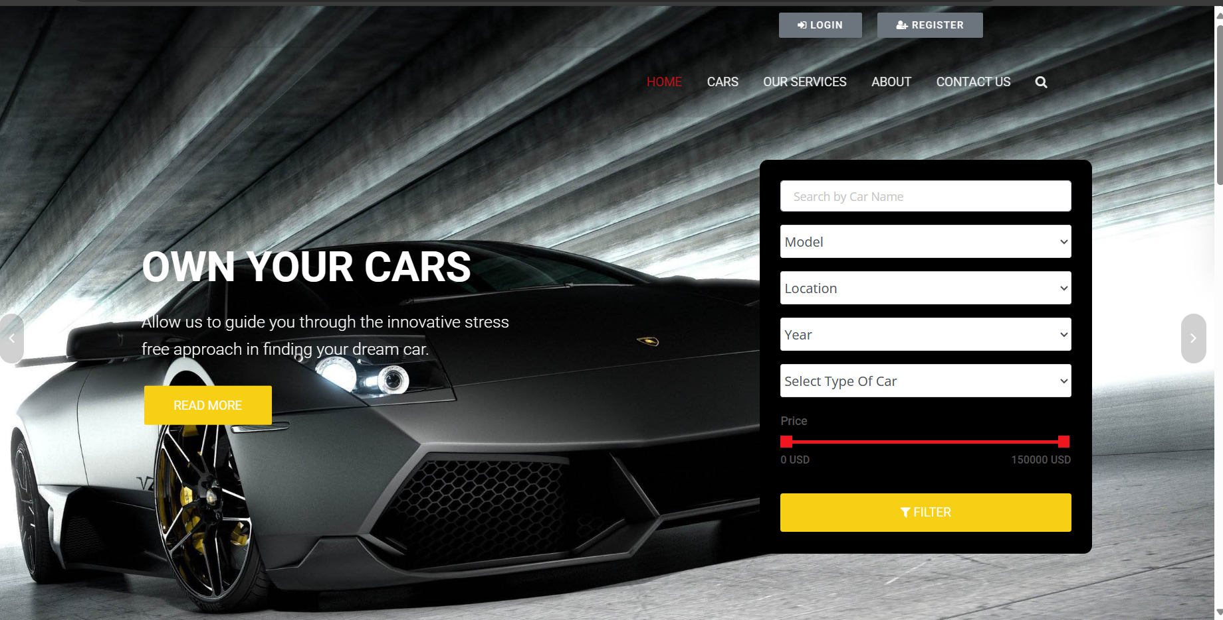
Homepage

Slide 12
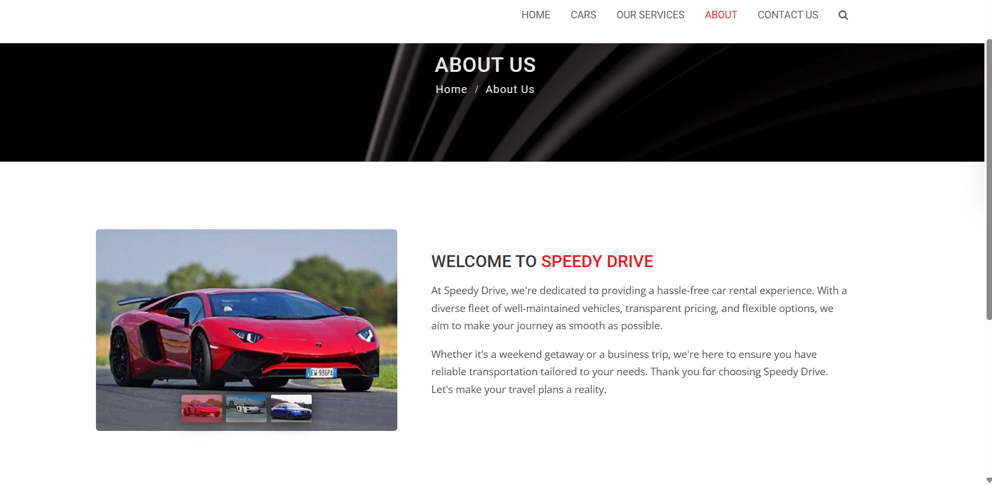
About-Us-Page

Slide 13
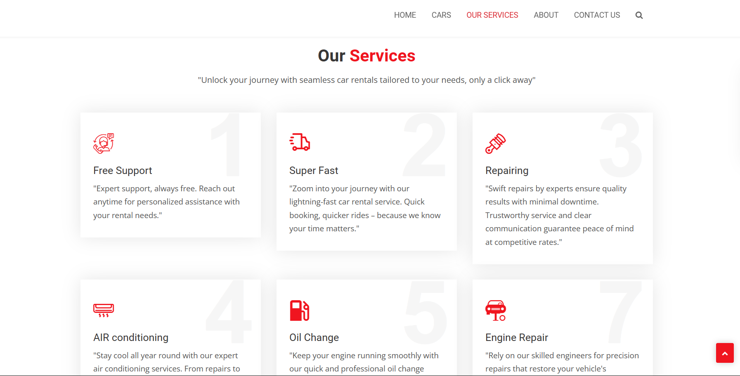
Service-Page

Slide 14
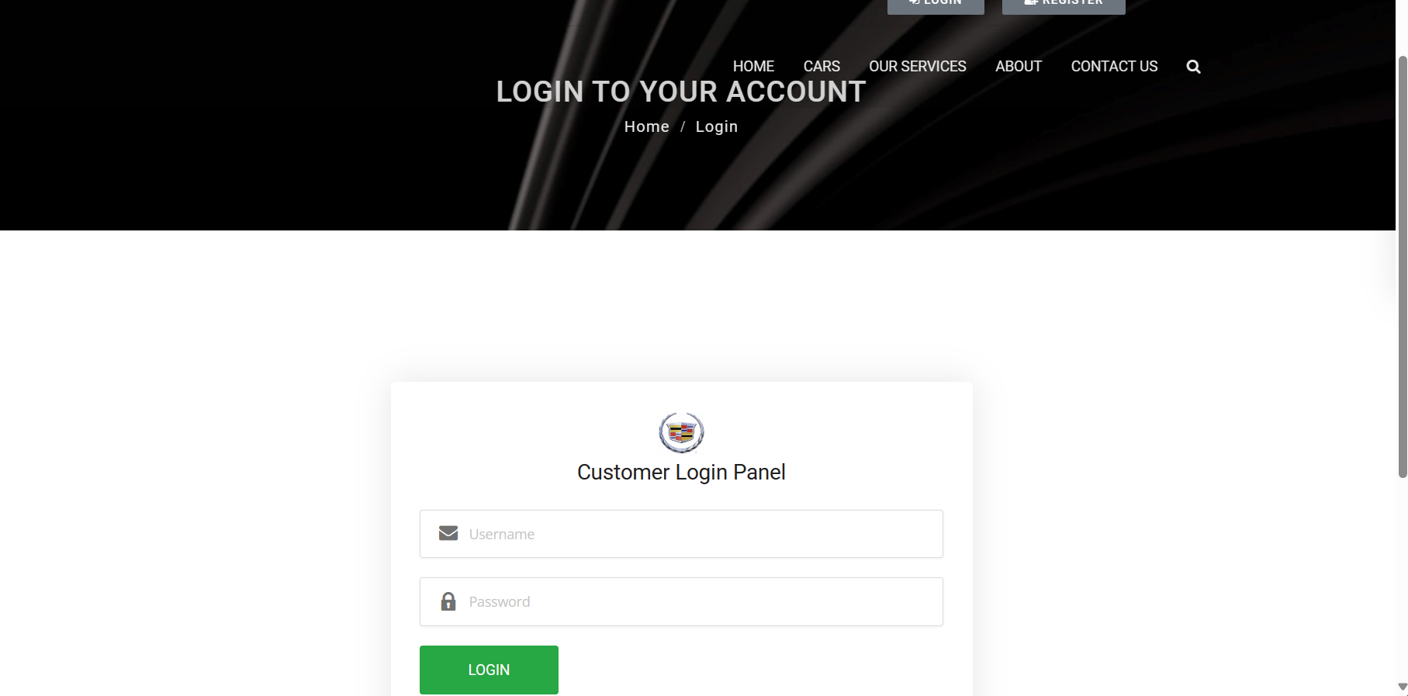
Login-Page

Slide 15
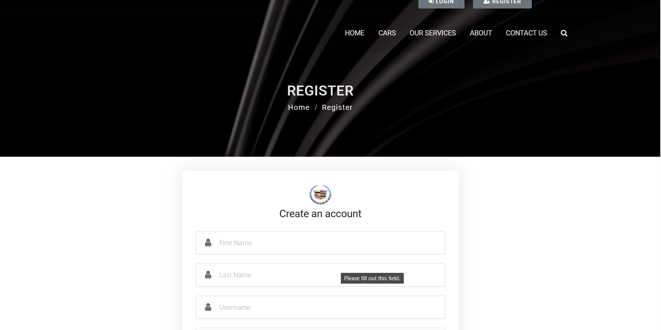
Register-Page

Slide 16
Future Enhancements:
Introducing personalized user experiences with tailored recommendations and
preferences.
Employing predictive analytics for demand forecasting, optimizing fleet
management.
Developing a mobile application for convenient on-the-go bookings and
management.
Integrating IoT devices for real-time vehicle data collection, enhancing
maintenance and security.
Expanding payment options with digital wallets, installment plans,
and cryptocurrency.
Implementing dynamic pricing algorithms to adjust rates based on demand
and availability.
Incorporating augmented reality features for immersive vehicle visualization..

Slide 17
Conclusion
The future enhancements outlined for a car rental application utilizing the Django framework promise to significantly elevate the user experience, operational efficiency, and market competitiveness. By embracing personalized experiences, predictive analytics, mobile accessibility, and innovative technologies like IoT and AR, the application can anticipate and meet user needs more effectively while optimizing fleet management and maintenance. The expansion of payment options, dynamic pricing strategies, and diversified services further solidify its position in the market, catering to a wider range of users and preferences. Additionally, a commitment to accessibility and social integration ensures inclusivity and community engagement, fostering long-term brand loyalty and growth. Through these enhancements, the car rental application is poised to remain at the forefront of the industry, delivering unparalleled value and service to users and stakeholders alike.
Source :

Slide 18
Thank You!
Notes:
Thank You !!

